Slide 1
Principles of Ecology

Slide 2
Organisms and Their Environment
Ecologists study the way organisms live in their environment.
Notes:
Things which are dead but which were once living are still considered biotic factors.

Slide 3
The Biosphere
The biosphere is all of the area of Earth which can support living things,
including the air, land, and water.
Living things are affected by nonliving things and by other living things.
Notes:
The biosphere extends from thousands of feet into the atmosphere to the bottom of the ocean.

Slide 4
Non-living Factors
Air currents
Temperature
Moisture
Light
Soil
Abiotic factors determine what organisms can live in an area.

Slide 5
Biotic (living) Factors
All organisms depend on other organisms for:
food
shelter (often)
reproduction
protection

Slide 6
Levels of Organization
A species is a group of similar organisms which can successfully interbreed.
A population is a group of organisms of the same species in an area.
A community is a group of interacting populations.

Slide 7
Levels of Organization, cont.
An ecosystem is all of the biotic and abiotic (non-living) factors in an area.
Suppose you’re a primitive human living during an Ice Age.
  An abiotic factor is: it’s COLD!
  A biotic factor is: there are sabertooth tigers to avoid.

Slide 8
Organisms in Ecosystems
A habitat is the place where an organism lives.

Slide 9
Symbiosis
“Living together”
A close and permanent relationship between species
Most species survive because of the relationships they have with other species (think of examples)
Notes:
Humans – E. coli

Slide 10
Symbiosis, cont.
Mutualism – both organisms benefit
  Example: humans domesticating sheep
Commensalism – one organism benefits, the other is not affected
  Example: humans tapping maple trees for sap
Parasitism – one organism benefits, the other (the host) is harmed
  Example: tapeworm living in a human
Notes:
Mutualism – ants & acacia trees (ants provide protection, trees provide nectar)
Commensalism – moss growing on a tree, clown fish protected by anemones’ stinging tentacles
Parasitism – tick, flea, tapeworm

Slide 11
Predator/Prey
A predator seeks out another organism for food.
The prey is the organism which gets eaten.
Notes:
Difference b/t a predator and a parasite: a predator kills and consumes its prey. A parasite may weaken but rarely kills its host.

Slide 12
Nutrition and Energy Flow
Producers: autotrophs make their own food
  Photosynthetic plants and green algae use energy from the sun to produce sugars
  Some bacteria use energy from chemical reactions to make nutrients

Slide 13
Nutrition and Energy Flow, cont.
Consumers: heterotrophs must eat other organisms to get their nutrition
  Herbivores eat plants
  Carnivores eat animals
  Omnivores eat both plants and animals
  Decomposers break down dead organisms into nutrients which are returned to the environment

Slide 14
Flow of Matter and Energy in Ecosystems
Carbon, nitrogen, and other elements pass from air and soil through producers to consumers and back into the air and soil.
Food chains and webs show the direction of energy flow through trophic levels.
Notes:
phosphorus

Slide 15
Flow of Matter and Energy in Ecosystems, cont.
A food chain shows a simple, linear pathway for movement of matter and energy.
A food web shows the relationships between interconnected food chains.
Arrows indicate the direction of energy flow.

Slide 16
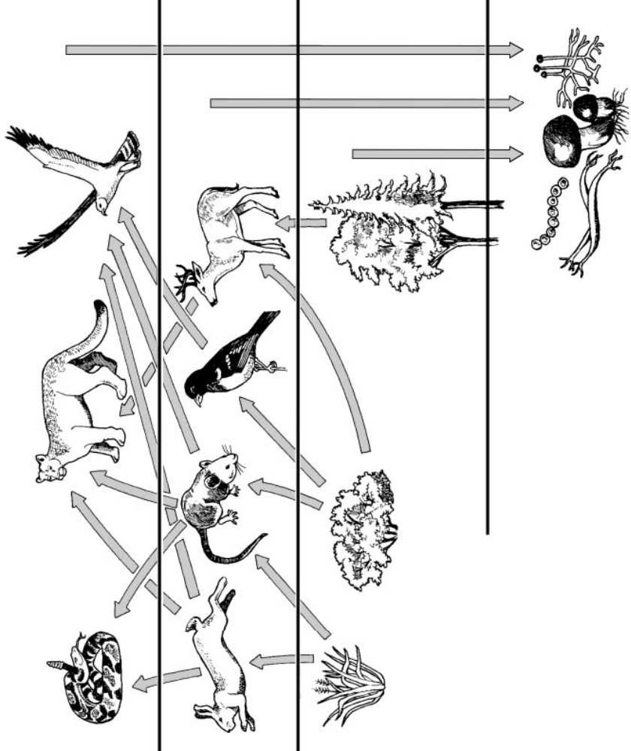
Mountain lions
hawks
Second-order heterotrophs
snakes
First-order heterotrophs
deer
mice
rabbits
Seed-eating birds
autotrophs
grass
shrubs
trees
A food web illustrates the complex feeding relationships by which matter and energy move through an ecosystem.
decomposers
Notes:
A food web illustrates the complex feeding relationships by which matter and energy move through an ecosystem.

Slide 17
1. At which level of the food web is the supply of energy the greatest? Explain.

Slide 18
1. At which level of the food web is the supply of energy the greatest? Explain.
The supply of energy is greatest at the level of the autotrophs – they are the most numerous organisms and get energy directly from the sun.

Slide 19
2. Which feeding relationship do first–order heterotrophs have in common?
They are all _________, or plant-eating animals.
3. Which feeding relationship do second–order heterotrophs have in common?
They are all _______, or __________ ___________.

Slide 20
2. Which feeding relationship do first–order heterotrophs have in common?
They are all herbivores, or plant-eating animals.
3. Which feeding relationship do second–order heterotrophs have in common?
They are all carnivores, or meat-eating animals.

Slide 21
4. Explain why plants are called autotrophs.
“Auto” is Greek for “self”. Since plants make their own food during ____________, they are called autotrophs.

Slide 22
4. Explain why plants are called autotrophs.
“Auto” is Greek for “self”. Since plants make their own food during photosynthesis, they are called autotrophs.

Slide 23
5. Food webs and food chains both involve multiple trophic levels. How do they differ?

Slide 24
5. Food webs and food chains both involve multiple trophic levels. How do they differ?
Food chain: depicts a single sequence of feeding relationships.
Food web: represents a network of interrelated food chains.

Slide 25
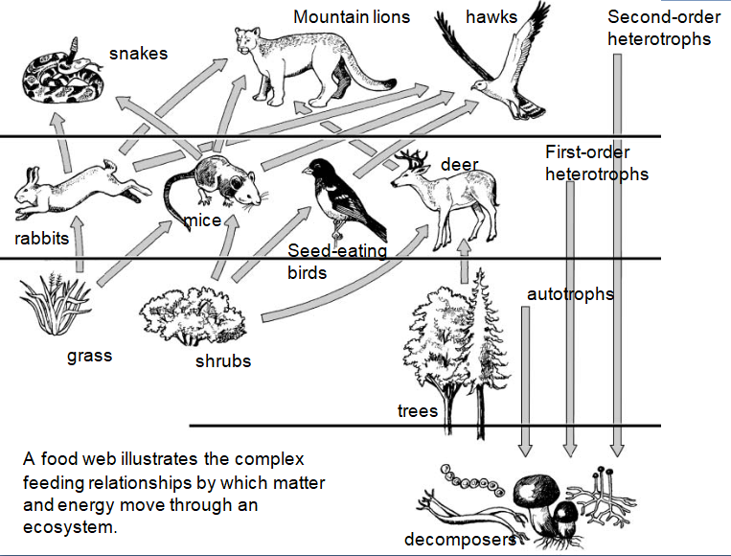
6. Describe a food chain that includes a mountain lion and a shrub.

Slide 26
6. Describe a food chain that includes a mountain lion and a shrub.
The mountain lion might feed on a deer or mouse which has fed on shrubs, which depend on decomposers (bacteria and fungi) to recycle nutrients from dead organisms.

Slide 27
7. How might the organisms pictured in the food web be affected if most of the mouse population was destroyed by disease?

Slide 28
7. How might the organisms pictured in the food web be affected if most of the mouse population was destroyed by disease?
Other 1st-order heterotrophs, such as birds, rabbits, and deer, would have more food. All the 2nd-order heterotrophs pictured would experience increased competition for the remaining food sources, and those food sources might become depleted sooner.

Slide 29
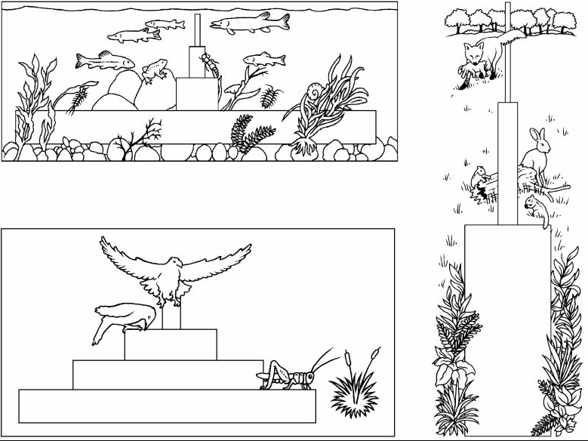
Top carnivores
carnivores
carnivores
herbivores
producers
herbivores
Pyramid of energy
Pyramid of numbers
Producers
Hawk 1
Robins 90
Grasshoppers 200
Grass 1500
Pyramid of Biomass

Slide 30
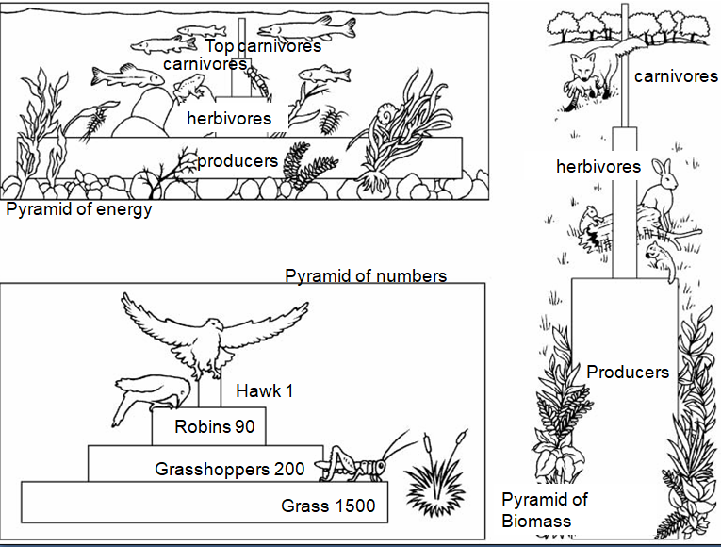
1. What is the source of energy for all of the ecological pyramids shown?
2. In general, what kind of organism makes up the base of the pyramid of energy? Provide some specific examples.

Slide 31
1. What is the source of energy for all of the ecological pyramids shown?
The sun
2. In general, what kind of organism makes up the base of the pyramid of energy? Provide some specific examples.
Autotrophs/producers, such as grass, trees, or algae

Slide 32
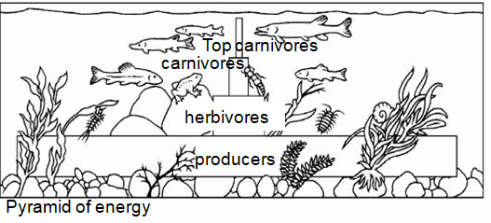
3. Examine the pyramid of energy. Explain why only about 10% of the energy available at one trophic level is transferred to the next higher trophic level.

Slide 33
3. Examine the pyramid of energy. Explain why only about 10% of the energy available at one trophic level is transferred to the next higher trophic level.
Not all of the available food is eaten.
Not all of the food eaten is digested.
Some of the energy in digested food is used for metabolism (chemical reactions used for life).
A lot of the energy is lost as heat.

Slide 34
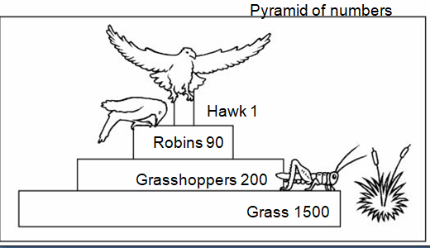
4. Suppose an ecosystem has a greater number of individual herbivores than individual producers. How would this affect the shape of the ecosystem’s pyramid of numbers?
The pyramid would be inverted – the top level would be wider than the bottom.
Example: ants on an acacia tree.

Slide 35
5. Explain how biomass is calculated.
The average weight of a species is determined and then multiplied by the estimated number of organisms within the population at that level.

Slide 36
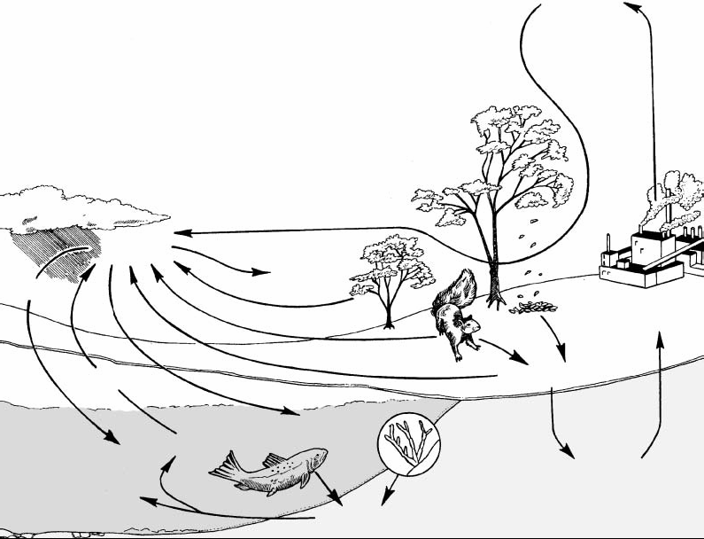
Burning of
fossil fuels
CO2 in
atmosphere
Photosynthesis
Precipitation
Industry and
agriculture
Respiration
Diffusion
Death, decomposition
Photosynthesis
CO2 dissolved in water
Calcium carbonates in
rocks and shells
Carbon compounds converted
to fossil fuels
Notes:
Carbon is the most important element in all living things. Proteins, carbohydrates, and fats all contain a carbon link.

Slide 37
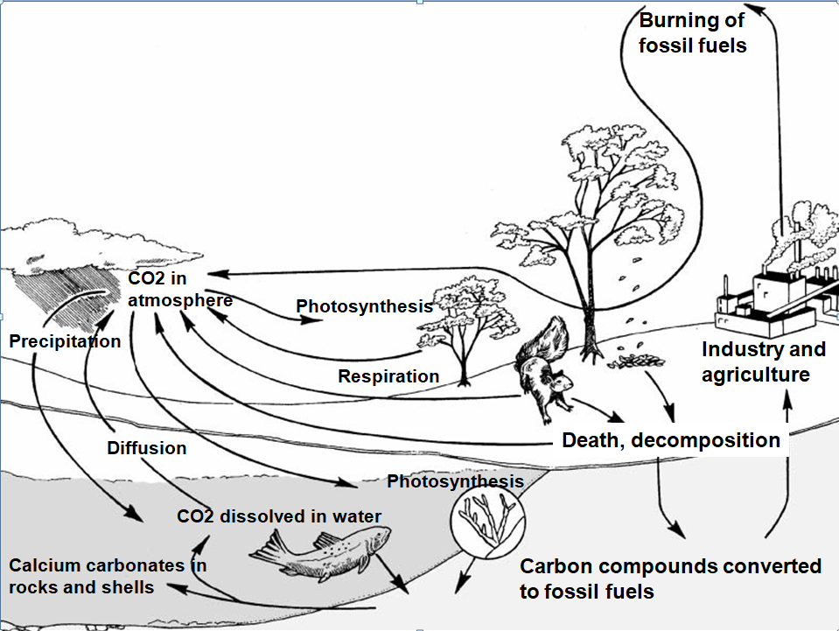
What is the process by which plants convert carbon dioxide into energy-rich carbon compounds?
2. Explain what can happen over millions of years to the carbon compounds in organisms that die and decompose.
3. What processes release
carbon dioxide into the
atmosphere?
4. Identify the two major reservoirs of carbon dioxide on Earth.

Slide 38
What is the process by which plants convert carbon dioxide into energy-rich carbon compounds?
Photosynthesis
2. Explain what can happen over millions of years to the carbon compounds in organisms that die and decompose.
They may be converted into fossil fuels
(coal, oil, natural gas)
3. What processes release
carbon dioxide into the
atmosphere?
Respiration, decomposition,
Diffusion from water to air,
burning of fossil fuels
4. Identify the two major reservoirs of carbon dioxide on Earth.
The atmosphere and the oceans

Slide 39
5. What are the forms in which carbon is found in the oceans?
6. How do plants and animals help to maintain a balance
of carbon dioxide in the atmosphere?
7. Atmospheric carbon dioxide might
produce a so-called “greenhouse effect”
by trapping heat near Earth’s surface.
What human activities might tend to
increase the greenhouse effect?

Slide 40
5. What are the forms in which carbon is found in the oceans?
Dissolved CO₂; carbon compounds in the bodies of fish, etc.; calcium carbonate in rocks and shells
6. How do plants and animals help to maintain a balance
of carbon dioxide in the atmosphere?
Plants remove CO₂ from the atmosphere
during photosynthesis. Plants and animals
return CO₂ to the atmosphere during respiration.
7. Atmospheric carbon dioxide might
produce a so-called “greenhouse effect”
by trapping heat near Earth’s surface.
What human activities might tend to
increase the greenhouse effect?
Destruction of plants, especially forests; burning of fossil fuels to produce energy for industry, agriculture, and transportation

Slide 41
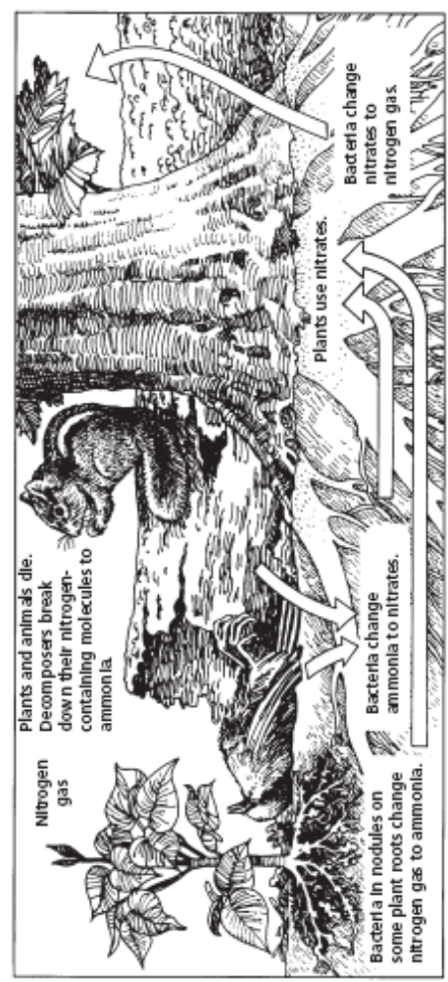
The Nitrogen Cycle – a series of chemical changes in which bacteria change nitrogen into a form plants and animals can use, and change it back after plants and animals die.
N₂
NH₃
NO₃⁻

Slide 42
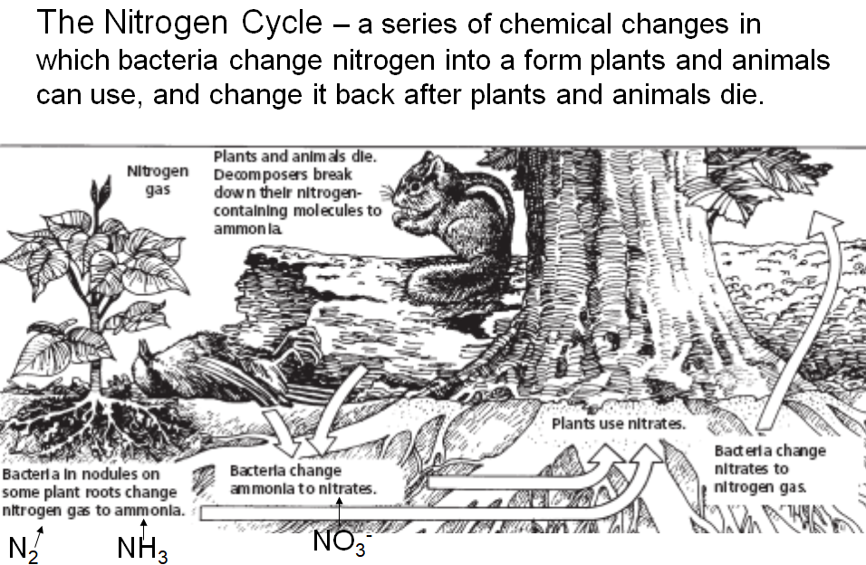
1. What percent of the air consists of nitrogen gas?
2. Bacteria in root nodules change nitrogen gas into what form?
3. What is the role of
decomposers in the
nitrogen cycle?
4. How do plants obtain
the nitrogen they need?

Slide 43
1. What percent of the air consists of nitrogen gas? 78%
2. Bacteria in root nodules change nitrogen gas into what form?
Ammonia (NH₃)
3. What is the role of
decomposers in the
nitrogen cycle?
Decomposers break
down nitrogen-containing
molecules in dead
organisms into ammonia.
4. How do plants obtain
the nitrogen they need?
Bacteria in soil convert ammonia to nitrates (NO₃⁻) which plants use to make nitrogen-containing molecules (proteins).

Slide 44
5. How do herbivores obtain the nitrogen they need?
6. How do other animals
obtain the nitrogen they
need?
Notes:
When an organism eats another organism, it breaks down the proteins, carbohydrates, fats, and amino acids it gets from that organism and uses the elements to make its own molecules of protein, carbohydrate, fat, or amino acid.

Slide 45
5. How do herbivores obtain the nitrogen they need?
Herbivores obtain nitrogen from the proteins in the plants they eat.
6. How do other animals
obtain the nitrogen they
need?
Carnivores obtain nitrogen from the proteins in the animals they eat.
Notes:
When an organism eats another organism, it breaks down the proteins, carbohydrates, fats, and amino acids it gets from that organism and uses the elements to make its own molecules of protein, carbohydrate, fat, or amino acid.

Slide 46
7. How is nitrogen returned to the atmosphere?
8. What would be the impact on the nitrogen cycle if there were a decrease in decomposition in a given ecosystem?

Slide 47
7. How is nitrogen returned to the atmosphere?
Bacteria change nitrates (NO₃⁻) in the soil into nitrogen gas (N₂).
8. What would be the impact on the nitrogen cycle if there were a decrease in decomposition in a given ecosystem?
Less nitrogen would be cycled to the atmosphere so less would be available to organisms.

